Slide 1
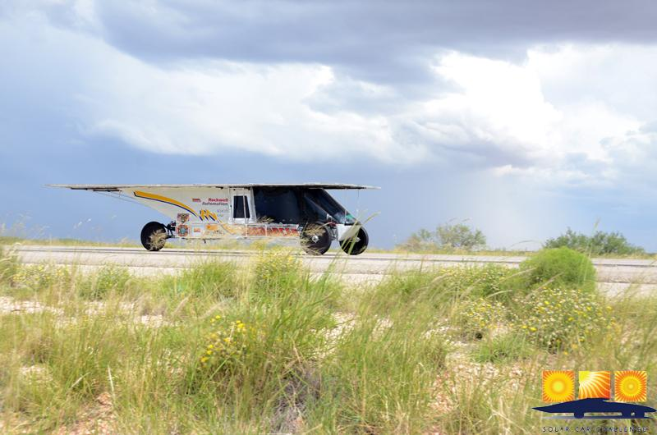
Things to Remember on a cross-country Race

Slide 2
We are all ambassadors of this solar car race . . . we represent our teams, our schools, and our sport. Take time to visit with “the curious.”
It helps to designate one of your team members as a Public Information Officer. Let this person visit with bystanders

Slide 3
Treat your judge with respect and cooperation. Designate one of the team members to be a liaison to promote good judge/team communication.
Keep your judge informed about your plans. A question asked before you do something “unwise” is always better than a penalty.

Slide 4
Be on time!
(1) Be on time for the 8:00 AM Drivers’ Meeting
(2) Be ready to line up your car according to starting order
(3) Be on time for meals
Teams arriving after the stated time in the “Where-to-Be” document are responsible for their own meals.

Slide 5
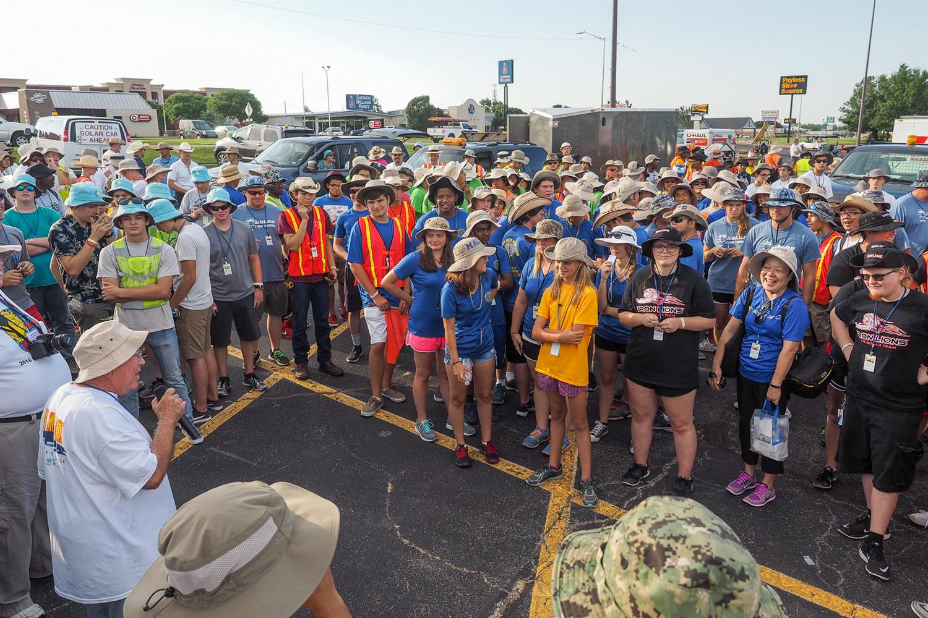

Slide 6
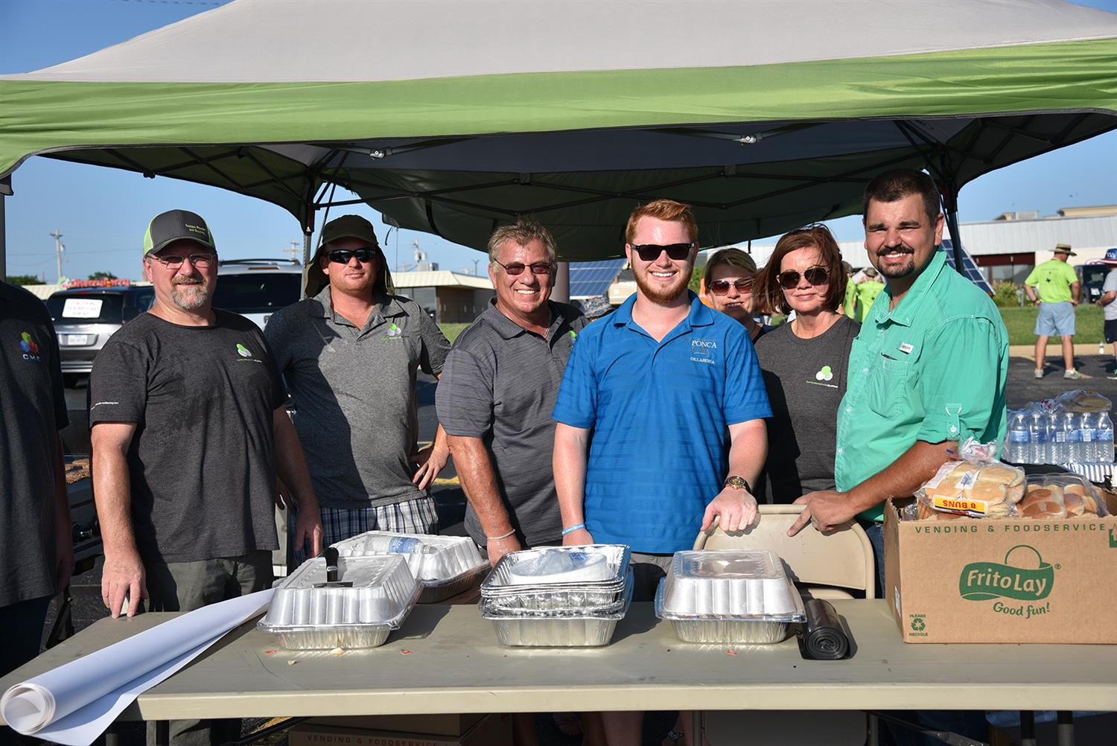

Slide 7
Be careful about what you say in public. Bystanders have been offended by thoughtless comments.

Slide 8
Driving into Stops Be sure to take part in all Lunch Stops, Media Stops, and Displays. If racing instructions indicate that solar cars will be driving into a Media or Lunch Stop, you must drive in to the if your solar car is capable of running. Visitors rarely get excited seeing a solar car on a trailer!

Slide 9
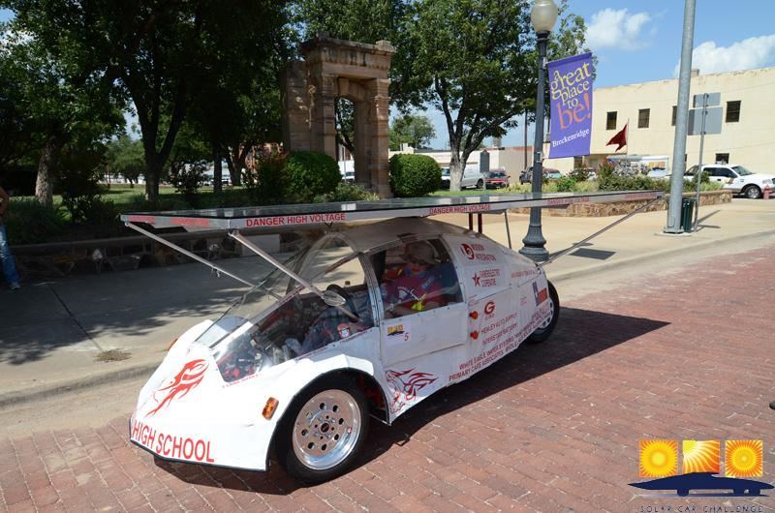

Slide 10
Pass another solar car with great care. Remember your four vehicles have to pass the other team’s four vehicles! If you have any kind of driving problem, tell your judge immediately

Slide 11
The Primary Chase Vehicle must always stay with the solar car. Failure to do so endangers the solar car/driver, and is a major penalty. It is crucial that teams closely monitor driving through intersections. If a team doesn’t think their solar car and primary chase vehicle can make it through a light, then don’t do it! Don’t leave your solar car exposed.

Slide 12
WARNING LIGHTS Make sure the Lead Car has a significant amber blinking light. Make sure that each of the two Chase Cars have 4 ECCO lights facing to the rear!

Slide 13
Student Conduct Students should conduct themselves properly at all times. This includes our time at the hotels.

Slide 14
Safety Issues We have to realize that onlookers, drivers, and media can drive in an unsafe manner just to get a better look at a moving solar car. They are our paparazzi! Teams need to drive defensively. Make sure your Lead Car-Solar Car-Primary Chase Vehicle drive as a “unit.” Don’t allow a driver to cut in between the solar car and the Primary Chase car.

Slide 15
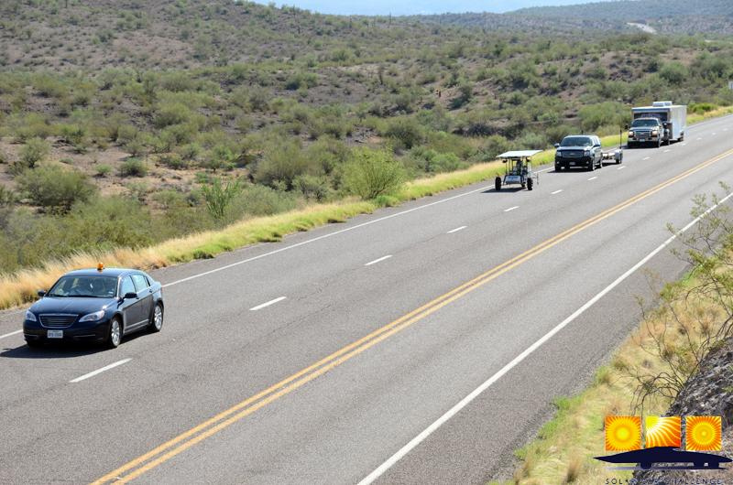

Slide 16
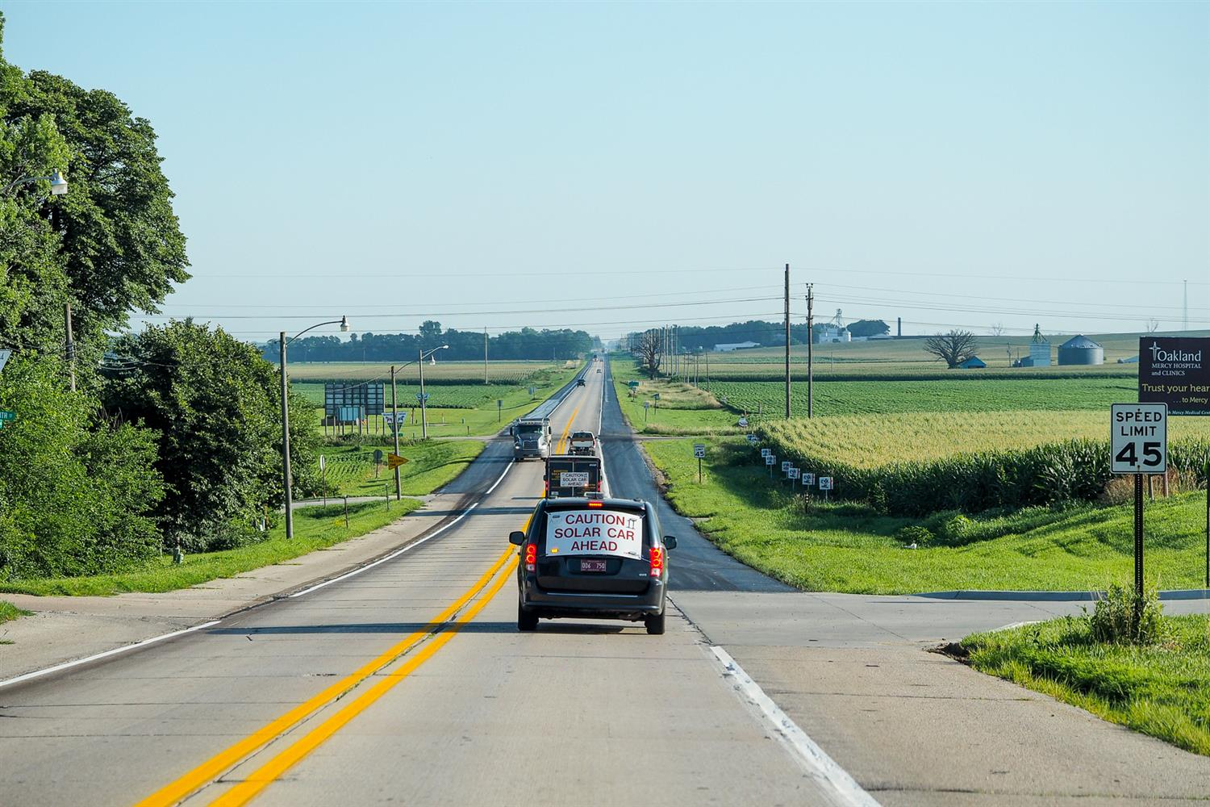

Slide 17
Continually monitor your solar car driver for heat issues. Rotate your drivers frequently! All race participants must wear hats when in the sun. Solar car drivers must wear shoes and have a hat available!

Slide 18
The race recognizes the ultimate authority for driving, team actions, and student conduct rests with the Team Adviser. Having said this, the Race expects teams to follow the safety requests by Race Officials. If any request appears to be too burdensome, teams are authorized to contact the Race Director for clarification

Slide 19
Impound Issues Don’t remove a solar car from the Impound without a judge being present. Your judge will be checking the following points each race morning: (a) Battery seals and connections (b) Driver Communication (c) Brake lights and turn signals (d) Safety Officer has necessary equipment (e) Chase vehicle lights

Slide 20
A Typical Race Day 6:30 AM Impound Opens [teams access solar cars] 8:00 AM Required Teams Meeting at Official Trailer 8:45 AM Solar Cars are lined up ready for Race Start 9:00 AM Race Start 10:30 AM Media or Rest Stop [15 minutes required] 12:30 PM Lunch Stop [30 minutes required] 2:30 PM Media or Rest Stop [15 minutes required] 5:00 PM Race Day Ends [trailer solar car if not at “end-of-race” 7:00 PM Meal together with other teams 9:00 PM Impound begins [no access to solar cars]

Slide 21
JUDGES (1) Judges will be seated in the Primary Chase Vehicle’s front row “shot gun” passenger seat. (2) Teams are responsible for providing water and lunch to their judge. Please note that the judge needs no special treatment. The judge will eat the same food as the team. (3) Judges cannot require a team to pull over to use “facilities” unless there is an emergency. Judges should use facilities when teams make their normal rest stops. (4) Judges will inform the team if they incurred a penalty. This will be announced shortly after the penalty was incurred to prevent the team from incurring the same penalty.

Slide 22
(5) The judge will not announce the size of the penalty. This will be determined by a panel of judges reviewing penalties each evening. The insures equality of penalties being assessed.
(6) Judges will not inform a team that they are “about” to incur a penalty.
(7) The team’s liaison can however discuss driving decisions with the judge to help the judge better understand the team’s intentions.
(8) Judges will not inform a team that they are “off course.”

Slide 23
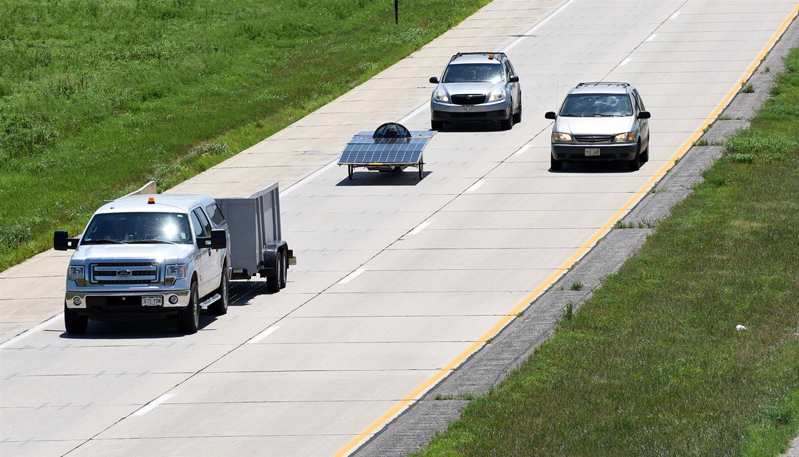

Slide 24
Calling Attention to Rules Affecting a Cross-County Race

Slide 25
Rule 13.1 Impound Overnight Rule 14 Mandatory Stops & Check Points Rule 15.1 Maintenance – any time except when inappropriate at a media stop of during Impound.

Slide 26
Rule 15.2 Batteries – Batteries not replaced or removed without consent of Event Director Rule 16 Accidents Reported Rule 17 Race Withdrawal

Slide 27
Rule 18 Pushing Rule 19.2 Cross-Country Support Vehicles [Detailed explanation] Rule 20.1 Overtaking – Notify your Judge and flash lights

Slide 28
Rule 23 Judges [detailed explanaton] Rule 24 Penalties (1) Disturbing Official Battery Seal (2) Battery replacement (3) Non-solar Charging (4) Failure to Comply with Stops (5) Failure to Allow Passing (6) Traffic Violations

Slide 29
(7) Failure to Attend Meetings (8) Unsportsmanlike Conduct (9) Failure to Comply with Regs (10) Failure to Secure (11) Hats (12) Closed-toe shoes (13) Protective Eyewear (14) Student Constructed Vehicle

Slide 30
Rule 25 Protests of Race Decisions Rule 27 Film Crews Rule 28 Appropriate Actions by Teams

Slide 31
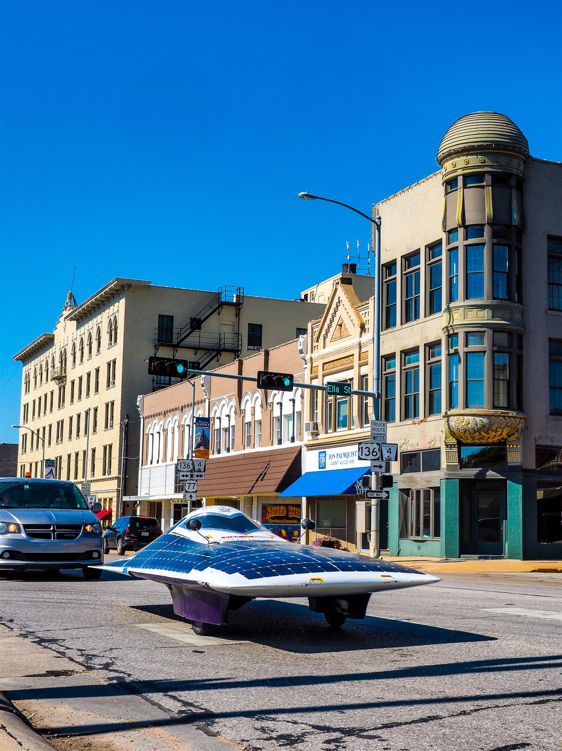

Slide 32
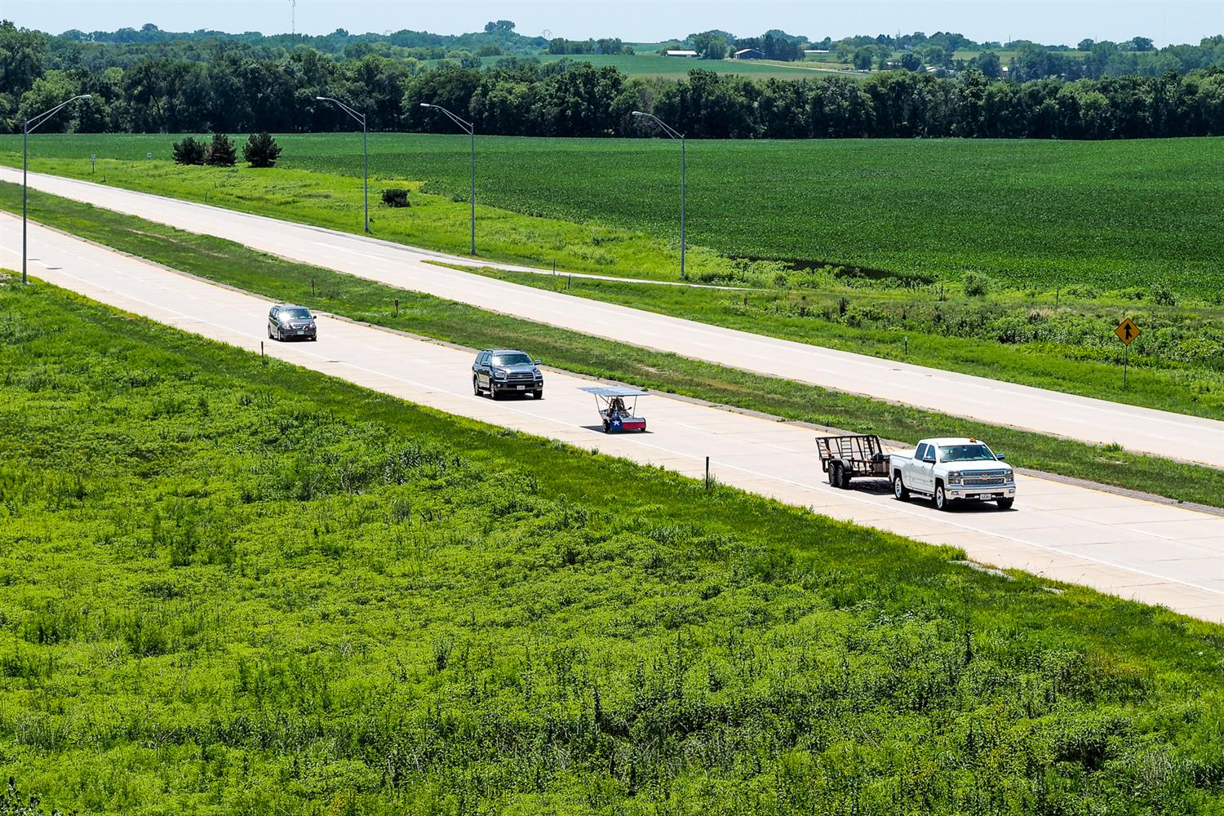

Slide 33
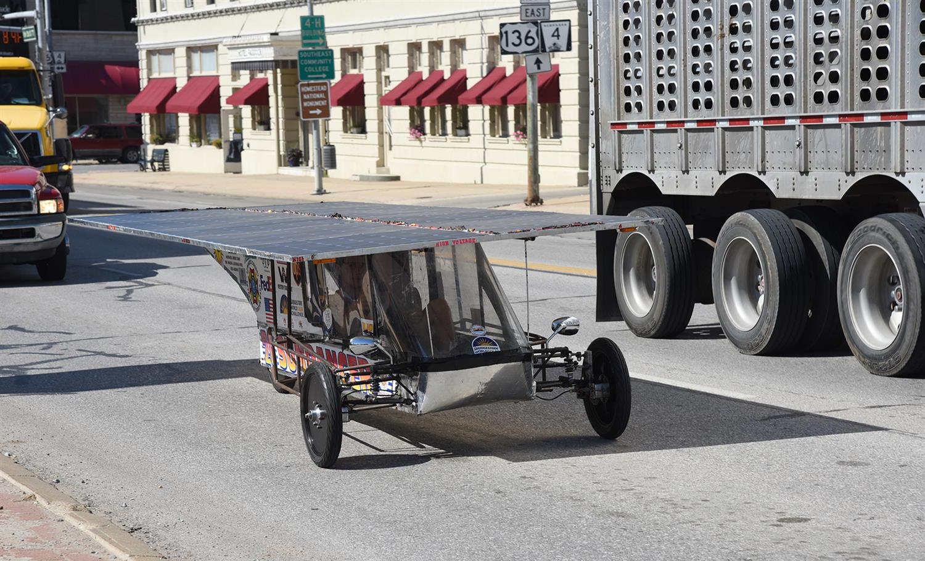

Slide 34
